Slide 1
BCI433 - IBM i Business Computing
Week 7: RPGLE Business Application - Lab 6

Slide 2
Agenda
Passing Parameters to RPGLE program
Using a CLLE driver Program
To run and manage RPGLE applications
File overrides for both PF and DSPF
Dynamic and Static Calls
Calling a Program or a Procedure
CL command CHKOBJ
Lab 6

Slide 3
Lesson Objectives
Upon completion of this lecture and lab 6 you'll be able to:
Pass a parameter to an RPGLE program
Provide file overrides to produce different report results
Create a CLLE module that passes a parameter to an RPGLE Module and combine them into a running program.
Check object's access/existence in program using CHKOBJ
Practice on using CL Driver program to run and manage business applications

Slide 4
Passing Parameters to an RPGLE Program
When run an RPGLE program, we can pass a parameter to the program from command line, like Java or other programs.
To implement this, we must define the parameter within the RPGLE program that receives the data:
Dcl-PI Main ExtPgm('PAYROLLPG2'); // must match the RPGLE program name
// i.e. PAYROLLPG2
ShiftType char(30); // parameter name and type
End-PI;
Run program from command line
==>Call PayRollPG2 Parm('D A Y S H I F T')
==>CALL PayRollPG2 'D A Y S H I F T'

Slide 5
Using a CLLE driver Program
One strategy regarding CLLE and RPGLE programming:
use CLLE program (as driver program) to run and manage (RPGLE program as) business application.
The driver program can be batch or interactive jobs
In Lab 6, the CLLE driver program RUNPAYGM2 or 3:
as a interactive program
Provides a simple menu using 'SNDUSRMSG' (rather than a display file)
call an pass parameter to the RPGLE program
manage 2 kinds of file overrides
show reports of different results

Slide 6
File Overrides
There are 2 kinds of file overrides used in the CLLE driver program:
Database file (PF) override with logical file
e.g. OVRDBF SHIFTWEEK NIGHTS
Spooled/printer file overrides
to override the printer file name, e.g.
OVRPRTF FILE(PAYRPT2) SPLFNAME(NIGHTSHIFT)
This way, the reports (printer file) name will be changed to NIGHTSHIFT

Slide 7
Creating Logical Files
As a database object, similar to physical files, logical files can be generated in 2 ways:
Using SQL, i.e. CREATE View viewname AS Select…
Using DDS code
In a source physical file, e.g. QDDSSRC, create a member of LF type for a logical file.
Don’t forget to compile it!
After compilation, a logical file will be created with the type of *file and the attribute of 'lf'
Don't forget to manually remove the older ??.*file.lf before re-compile a logical file.
Notes:
OR:
S FEESOWNED
S FINESOWNED
AND
S FEESOWNED
FINESOWNED

Slide 8
Logical File with DDS
LF example: create a logical file that sorts Item file by Name and Stocking Size (for PF file):
Level of entries
R: record format
K: key field, or index field
S/O: select / omit
may have more select/omit entries
functions: e.g.
COMP(GT 0), COMP(EQ 'JSMITH'), COMP(NE 'NY')
RANGE(10 59), VALUES (301542 306902 382101 486592 502356), …
R ITEMSR PFILE(ITEMS)
K ITEMNAME
K STOCKSIZE
S STOCKQNTY COMP(GT 0)
Notes:
OR:
S FEESOWNED
S FINESOWNED
AND
S FEESOWNED
FINESOWNED

Slide 9
Logical Files in Lab 6
You need to create all three logical files:
DAYS, NIGHTS, AFTERNOON
You may create a logical file ALL or ALLSHIFTS for all shifts
By removing the last (s or select) line from DAYS, or …
For easy implementation of your driver program
Note: when you update a logical file, you must manually delete the existing logical file (object). Otherwise, new object will be produced.

Slide 10
Dynamic and Static Calls
In ILE (Integrated Language Environment), your programs can call either a program or a procedure. However, the caller uses different call statements for programs and for procedures.
Dynamic Program Calls:
a program calls another program
Static Procedure Calls:
used to call:
a procedure within the same module
a procedure in a separate module within the same program
…

Slide 11
Dynamic and Static Calls
Program | Procedure | Comments
*PGM | *MODULE | Compiled to
CRTBNDRPG | CRTRPGMOD | Compile command for RPGLE code
CRTBNDCL | CRTCLMOD | Compile command for CL code
 | CRTPGM | Command to create *PGM with modules combined
DYNAMIC CALL | STATIC CALL
CALL | CALLB (CALL BOUND) | The statement called by RPGLE code
CALL | CALLRPC (CALL PROCDURE) | The statement called by CLLE code
 | DSPPGM | Display program with module(s)

Slide 12
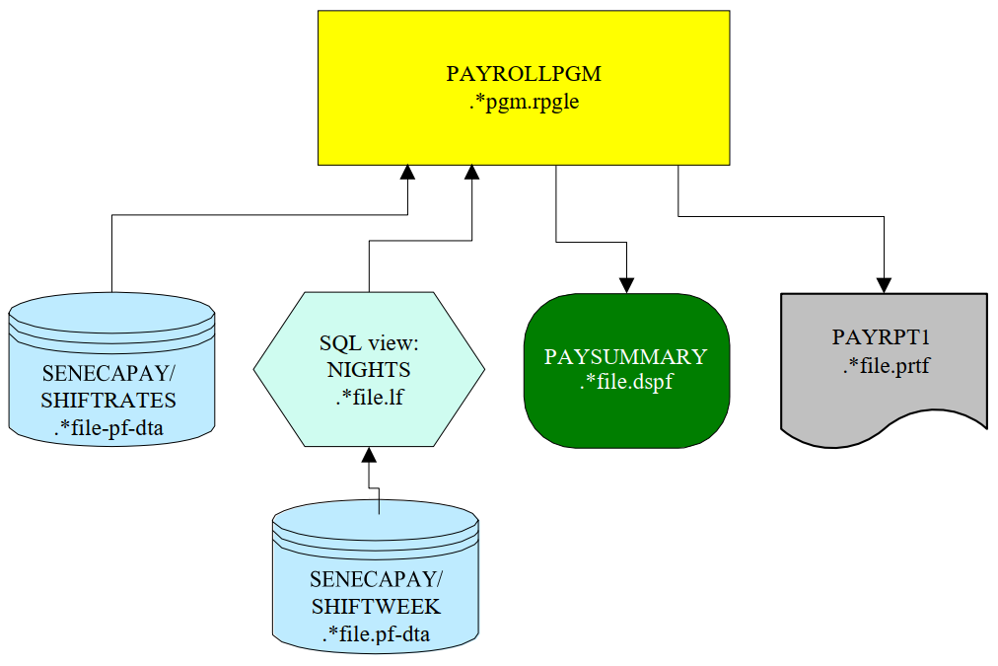
RPGLE Business Application (with Printer/Database Files)
Lab 5 files:

Slide 13
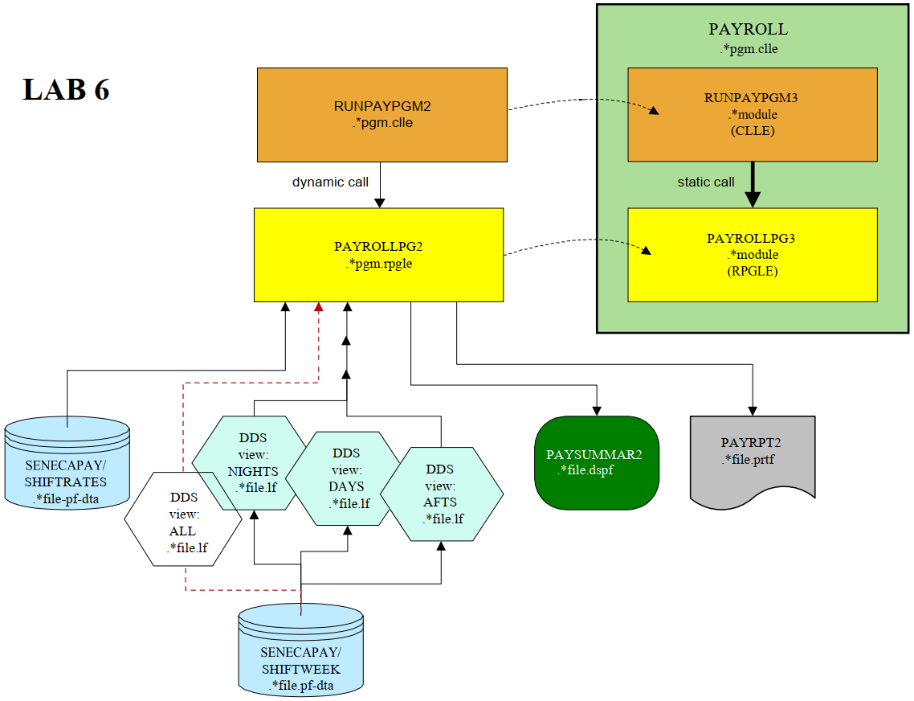
RPGLE Business Application (CLLE Driver/Dynamic & Static Calls/File Overrides)

Slide 14
Homework
Review lecture notes.
Week 7:
Lab 6

Slide 15
Lab 6 Demo

Slide 16
The End

